Slide 1
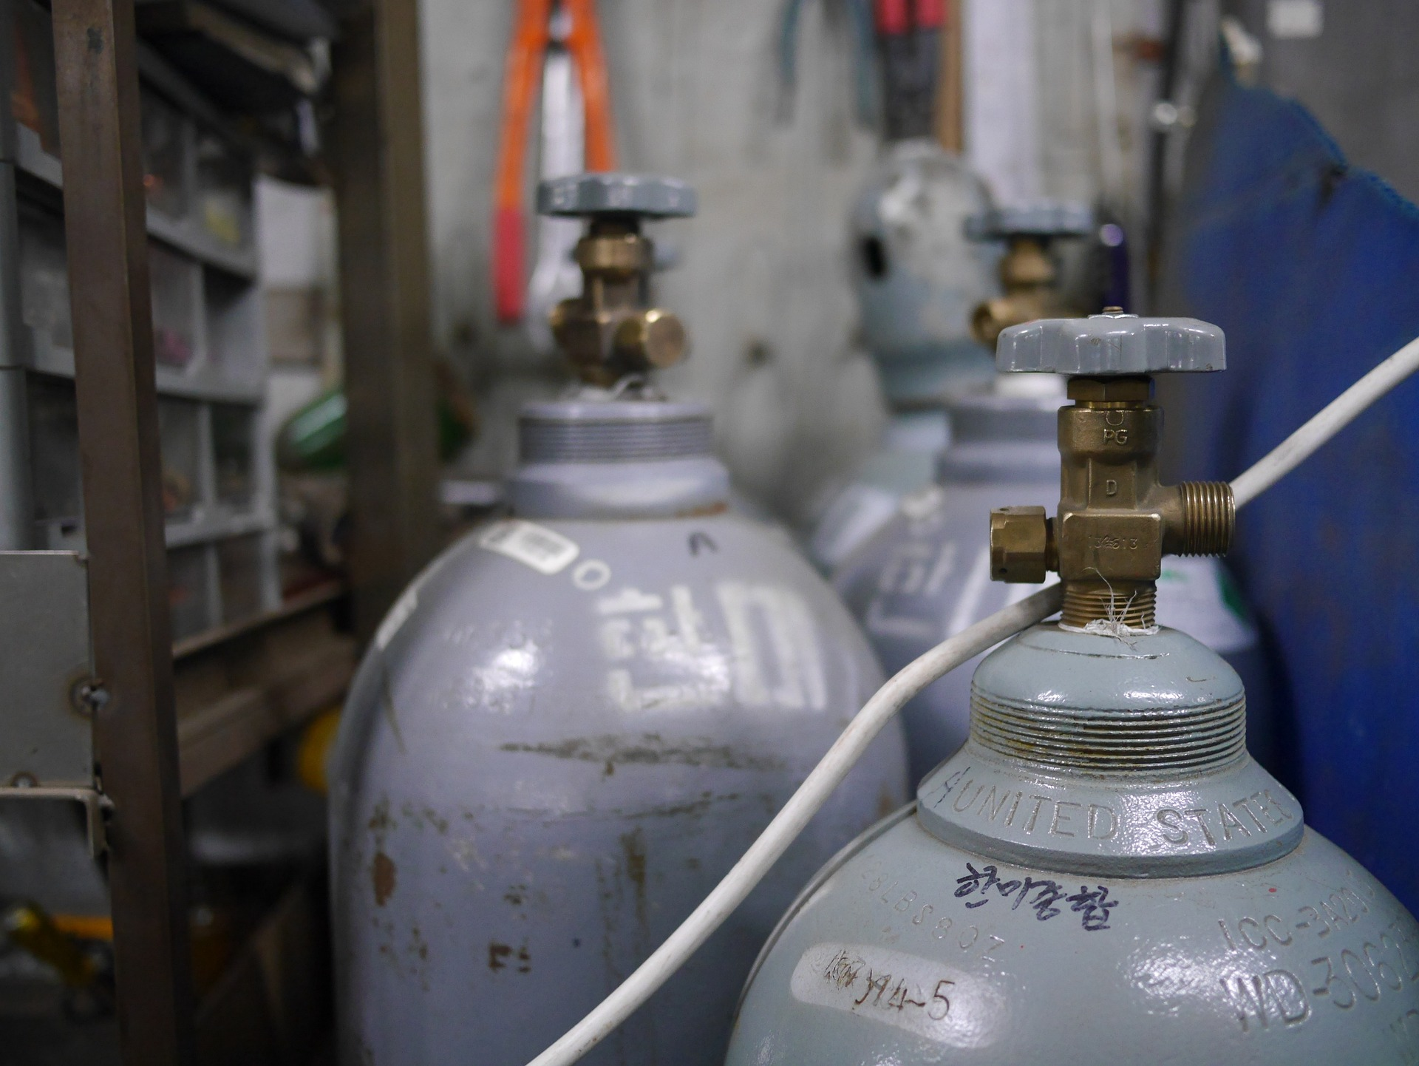
An Overview On
Automatic Gas
Leakage Detection
"Stay ahead of danger: Automatic gas leakage detection provides round-the-clock vigilance, keeping you safe when you least expect it."

Slide 2
Introduction to Automatic Gas Leakage Detection
An automatic gas leakage system is designed to detect the presence of gas leaks in an environment, such as homes or industrial settings, and alert occupants to potential dangers. These systems typically use sensors to detect the presence of gas, and when a leak is detected, they trigger alarms or shut off the gas supply to prevent accidents or explosions. They are crucial for ensuring safety and preventing hazards associated with gas leaks.

Slide 3

Equipments needed for this project:
ESP 8266 (NodeMCU)
Gas Sensor
Exhaust Fan
LED
Buzzer
Breadboard
9V,1A Power Converter

Slide 4
Procedure
The gas level is first sensed by the gas sensor installed in the MQ135. As an analog input device, it measures values from 0 to 1024+, which are then converted to a 0-100 scale using the function "sensor=map(sensor,0,1024,0,100)".
If the gas level is less than 20%, then the green LED will glow continuously, indicating a normal level. However, if the gas level exceeds 20% but is less than 50%, the green LED will turn red and start blinking. The exhaust fan will also be turned on, and a warning notification will be sent to the user's mobile device.
If the gas level exceeds 50%, the red LED will glow continuously, and the exhaust fan and a buzzer will be activated. Additionally, a warning message will be sent to the user's mobile device.
Users can monitor the gas level value at any time using the Blynk IoT mobile application. To integrate it with Blynk IoT, add new devices, add new datastream, and set up virtual pin V1. Enter the SSID, PASS, and auth token of the network to which ESP 8266 is to be connected. Turn on the WiFi network of your mobile application, and you're good to go.

Slide 5
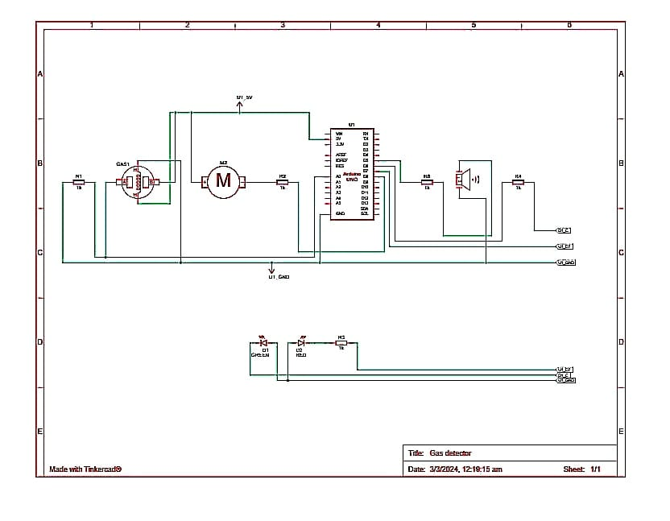
Circuit Diagram

Slide 6
Cost of the project
This document provides an estimated cost breakdown for the Automatic Gas Leakage Detection Project. The primary objective of this project is to enhance the safety of individuals and protect their property from potential gas leaks.
Below is a breakdown of the estimated cost of the project:
-ESP8266: Rs. 300/-
- Gas Sensor: Rs. 199/-
- Exhaust Fan: Rs. 200/-
- Buzzer: Rs. 10
Total Estimated Cost: Rs.709/-.

Slide 7
How Gas Detectors Work
Gas detectors work by utilizing various technologies to measure and indicate the concentration of specific gases in the air, aiming to prevent toxic exposure and fire hazards.Gas detectors measures the gas concentration levels and trigger alarms when gas levels exceed predefined thresholds .These detectors are crucial for safety in both domestic and industrial settings.

Slide 8
Importance of Automatic Detection
Automatic Gas Leakage Detection Systems are crucial for ensuring safety in both residential and commercial settings. They help detect leaks early, preventing potential accidents such as fires or explosions. These systems provide real-time monitoring, alerting occupants and authorities immediately upon detecting any gas leakage, allowing for prompt action to mitigate risks. Overall, they play a vital role in safeguarding lives and property from the dangers associated with gas leaks. Automatic gas leakage detection systems offer continuous monitoring, early warning capabilities, reduced response time, and improved safety measures, minimizing the risk of accidents and potential damage.

Slide 9
Application of gas leak detectors both residentially and commercially
Residential use
Commercial use
Gas leakage detection systems are used in residential settings to ensure the safety of occupants and property. They are installed in homes to detect leaks from natural gas pipelines, propane tanks, or gas appliances such as stoves, water heaters, and furnaces.
Gas leakage detection systems are installed in commercial buildings, including offices, hotels, restaurants, and shopping centers, to monitor gas pipelines and appliances and prevent accidents or disruptions in operations.

Slide 10

Future Implementations
Gas detection technology has been advancing rapidly. Smart sensors, IoT integration, and data analytics have been developed to enhance gas leakage detection systems, improving their efficiency and reliability.

Slide 11
Safety Measures
Safety measures are essential to prevent gas-related accidents and ensure the well-being of individuals. Here are some key safety measures to consider:
Regular Maintenance
Proper Installation
Ventilation
Emergency Procedures
Presence of Gas Shut-off Valves
By implementing these safety measures, individuals and organizations can minimize the risk of gas-related accidents and create a safer environment for everyone.

Slide 12

Thank You
Any Questions?
“PREVENTION IS KEY: Automatic Gas Leakage Detection saves lives, protects property, and ensures peace of mind”

